Slide 1

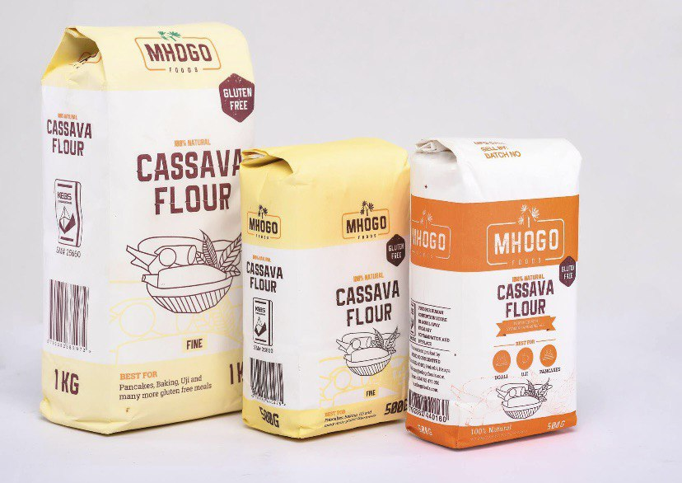


YARP
FORTIFIED
YARP
FORTIFIED
Every baker’s savior…

Slide 2

INTRODUCTION
YARP foods is an agro-processing start-up which is into the production of fortified cassava flour as a substitute for wheat flour.

Slide 3
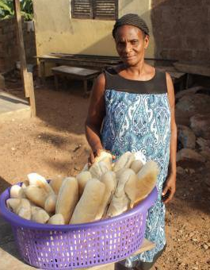
TARGET PERSONA
Meet Ante Serwaa
However, the rising cost of wheat flour has led to the closure of her bakery business,
A passionate small-scale baker in Sunyani,
She started her bakery with a passion for homemade bread and pastries
leaving her financially handicapped.

Slide 4

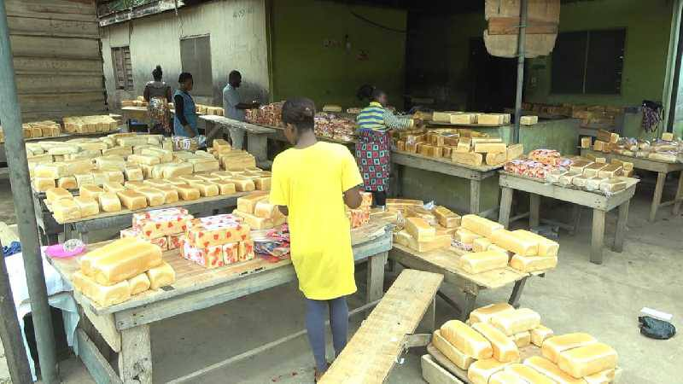

The Problem
FARMER
INDUSTRIES
The cassava value chain faces a loss of 10 million tons.
Huge wheat flour importation costs are raising production costs.
Pushing most flour users, like Ante Serwaa, out of business.
Reduces farmers income.

Slide 5
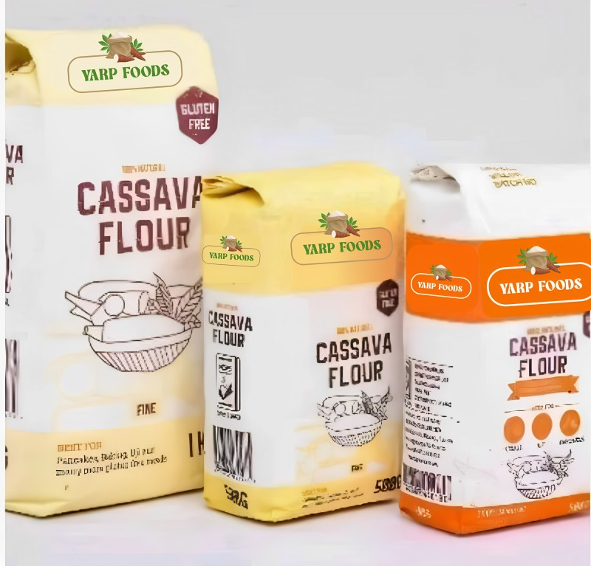
INTRODUCTION
OUR SOLUTION
We provide you with Fortified cassava flour as an alternative, high-nutrient, and cost-effective flour for flour users like Ante Serwaa.

Slide 6
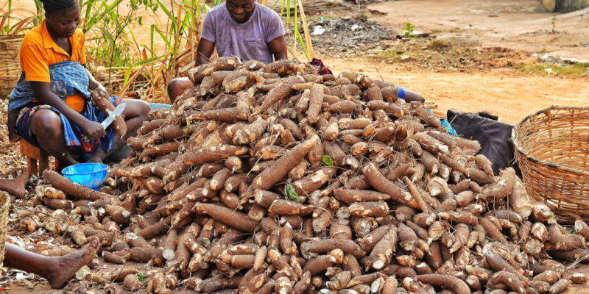
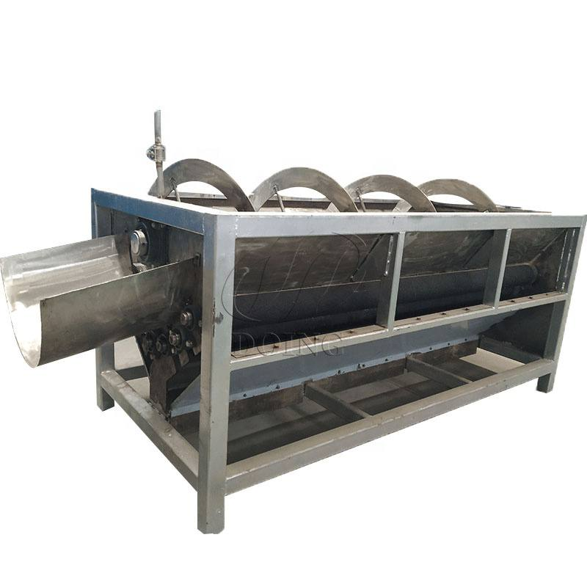
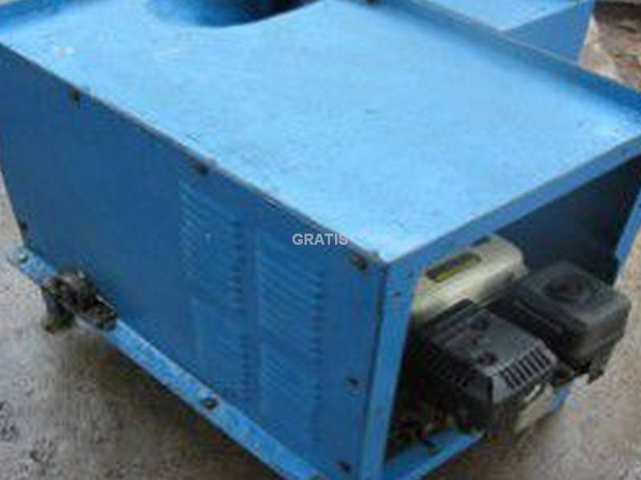
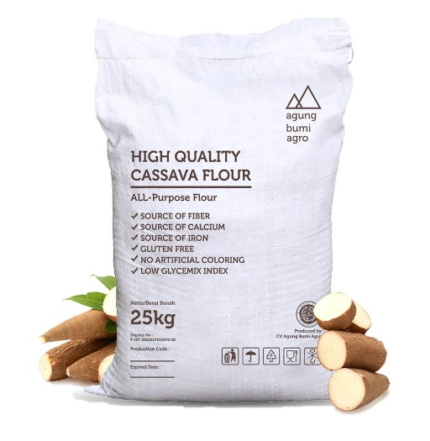
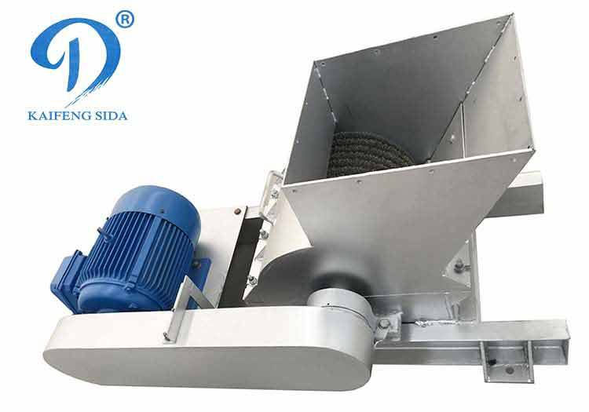
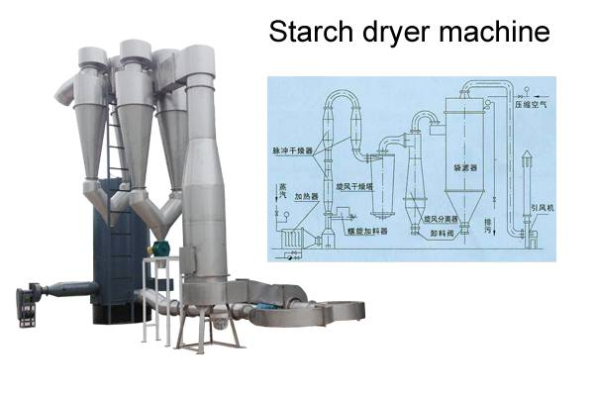
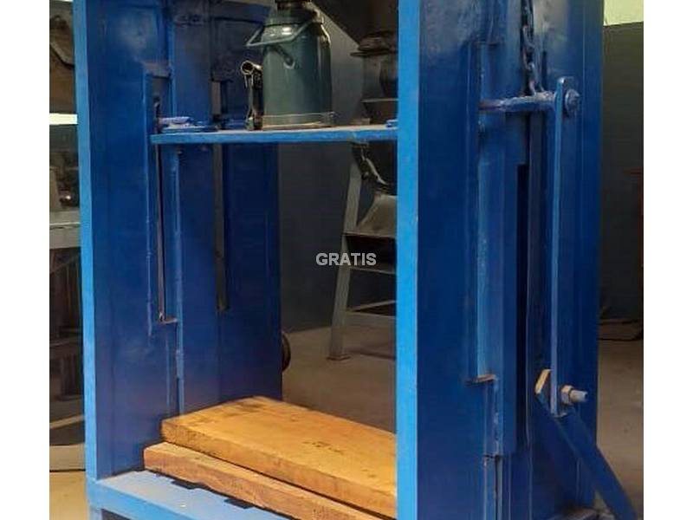
HOW IT WORKS
Cassava Peeling
Cleaning
Crushing
Packing
Milling
Drying
Dewatering

Slide 7




Highly refined and better quality
Highly nutritious
VALUE PROPOSITION
Affordable
Market Versatile

Slide 8












Impact on Small Holder Farmers.
Farmers get additional revenue of about $7,662.28 per season, which is a 30% increase in their income.
Increased Employment
8 direct jobs and 2 indirect jobs, would be created within one year of operation.
1
2
Women And Vulnerable Group Empowerment.
70% of workers to be employed will be women, and vulnerable group.
IMPACT
3
4
Farmers Support Service
5% of the annual profit will be set aside to support cassava farmers.
5
Impact on Environment
Processing cassava peels will help reduce emissions of methane, which contributes to climate change.

Slide 9

Competitor Analysis
Source of raw material
Competitor
Low Price
Fortified
Farmers supportive system
YARP foods
 |  |  | Local
 |  |  | Local
 |  |  | Local
 |  |  | Local
 |  |  | Imported
$ 40.34
Christaa Agri Ventures
$ 46.42
Fountain flour
$ 50.64
Karma 3BTN
$ 42.20
Takoradi Flour Mill
$ 50.00

Slide 10









INTRODUCTION
COLLABORATORS & PARTNERS
MoFA
Sunyani Bread Bakers Association

Slide 11
MARKET SIZE
SAM
$25.8m
(Ghana market Size)
$19Bn
SOM
$3.87m
7
TAM
$34 Bn
(Africa market Size)
(Target market Size)
Source: Statista, Food Dive/ Tridge

Slide 12

GO-TO-MARKET-STRATEGY
Target Market
Awareness
Distribution
1. Bread bakers
2.Food& Pharmaceutical companies
3. Wholesalers
4.Retail Outlets (stores, supermarkets, Malls)
6. Export
1.Target market engagement.
2.TV & radio advertisements.
3.Market display & Exhibitions
.
4.Digital marketing.
5.Collaborations & Partnerships
Shops, malls & Supermarkets
Website & Delivery
Air and Sea Freight

Slide 13

MARKET RESEARCH FINDINGS
Availability of Raw Materials
79 tons of cassava will be needed monthly. About 1.32 million tons of cassava goes to waste annually on the average in the Bono Region (FAO, 2012), and hence can guarantee 100% supply of raw material.
1
Feasibility of Business
Cassava flour production business is highly viable , given the country’s ample cassava supply, increasing market demand, and high potential financial returns.
2
Nutritional Component
Existing cassava flours on the market lack some nutrients, fortifying cassava flour with nutrients makes it highly demanded as it addresses nutritional challenges in Ghana..
3
Competition
Fortified cassava flour is more nutritious and affordable than wheat flour, making it a practical choice for local bakeries and households.
4
5
Patronage
90% of the bakers and pastries companies visited are currently using wheat flour, which is expensive, and are willing to switch to fortified cassava flour should it be more affordable and nutritious.

Slide 14

INTRODUCTION
REVENUE MODEL
Fortified Cassava flour 50 kg bag
Cassava Peels 50kg bag
Unit Cost: | $ 29.41
Selling Price: | $ 40.34
Profit Margin: | 37.8%
Unit Cost: | $ 1.69
Selling Price: | $ 4.22
Profit Margin: | 60%

Slide 15

CASH FLOW STATEMENT
DESCRIPTION | Q4 2023 ($) | Q1 2024 ($) | Q2 2024 ($) | Q3 2024 ($)
Cash Sales | - | - | 29,524.63 | 59,049.27
Receivable Collected | 589.53 | 2000 | 25,000 | 25,000.00
Total Cash Inflow | 589.53 | 2000 | 54,524.63 | 84,049.27
Expenses:
Market Research | 210.55 | - | - | -
MVP development | 378.98 | - | - | -
Transportation |  | 42.23 | 830.54 | 1,661.08
Raw materials |  |  | 3,322.15 | 6,644.30
Packaging Materials |  |  | 567.54 | 1,135.08
Lab chemicals |  |  | 83.89 | 209.73
Advertising |  |  | 84.22 | 252.66
Stipend:
Salaries ($ 110.74 per person/month - 4 permanent employees) |  |  | 664.44 | 1,771.81
Labour ( $4.19 per Labourer/day - 4 people) |  |  | 553.08 | 1,106.16
Purchase of Capital Assets:
Factory site, farm land(30) and building |  | 1,176.11 | 3,716.21 | 3,798.81
Documentation and License |  | 83.89 | 220.04 | -
Machines (Chipper, Grinder, dehydrator,pressor) |  |  | 12,486.49 | 5,000
Equipment and Tools |  | 50 | 396.11 | 844.59
Supply centers (rent) |  |  | 506.51 | 1,182.43
Vehicles |  |  | - | 5,065.08
Utilities:
Water |  |  | 16.88 | 33.76
Electricity Bills |  |  | 41.95 | 83.89
Total Cash Outflow | 589.53 | 1352.23 | 23490.05 | 28,789.38
Net Cashflow | 0 | 647.77 | 31034.58 | 55259.89
Opening Cash Balance | 0 | 0 | 647.77 | 31682.35
Ending Cash | 0 | 647.77 | 31682.35 | 86,942.24

Slide 16
INTRODUCTION
CASHFLOW CHART

Slide 17


INTRODUCTION
PRODUCT ROADMAP
Q4, 2024
Cassava peel feed, All purpose Cassava flour for food and pharmaceutical companies product development
2025
Cassava flour noodles, and pastries product development
Q4, 2023
Market Research, Business Development, MVP testing,
Feedback acquisition
Securing Partnerships, Product Development
Q1, 2024
Business registration,
Customer Acquisition and
testing Feedback collection, Publicity
Q2, 2024
Product launching, Setting up processing facility, and FDA registration
Q3, 2024
Full product Deployment/ marketing and sales /cassava farming to supply factory
6
5
4
2
3
1

Slide 18




INTRODUCTION
MEET THE TEAM
Andy Donsah Yeboah
Team & Production Lead
Chemist & 4 yrs. experience in food chemistry
Amponsah Ankrah Richard
Agri Research & Admin. lead
Agri Engineer & 4 yrs. experience in post-harvest loss
Louisa Yeboah
Business development & Marketing lead
BSC Hospitality & Business Management
Otu Prince
Operation & Finance lead
Mechanical Engineer & machinery expert

Slide 19
THE END
THANK YOU

